Slide 1

Development of Motion Planning Algorithms for Inchworm Robots
RBE 550 Project
Alex Tacescu, Meha Mohapatra,
Sri Kalimani, Nicole Kuberka
Notes:
[Sri]
Your project proposal slide is expected to have the following sections:
Research Question
Application Impact
Related Work
Proposed Method
Evaluation
Task Division & Timeline

Slide 2
Develop a system to plan the 2D motion of a 3-DOF inchworm robot to a desired location.
Notes:
[Sri]
Where traversal includes the planning the inching motion of the robot and creating a path to the desired location

Slide 3

Problem Statement
Resource Allocation
w.r.t. Construction
2018 US Private Industries Fatalities
25 to 50% waste
in labor and material management
$15.6 billion loss
per year due to the lack of interoperability (2004)
~21% or 1008 lives lost during construction compared to other industries
Notes:
[Meha]
There is an estimated “25 to 50 percent waste in coordinating labor and in managing, moving, and installing materials” with “losses of $15.6 billion per year due to the lack of interoperability” in the U.S. alone [2]. The construction industry in the U.S. has a higher fatal injury rate than the national average among different industries. In 2018, 21.1% of all fatalities in the private industry came from the construction sector, totalling 1008 lives.
With rapid increases in population growth, the construction industry is inefficient and dangerous.

Slide 4
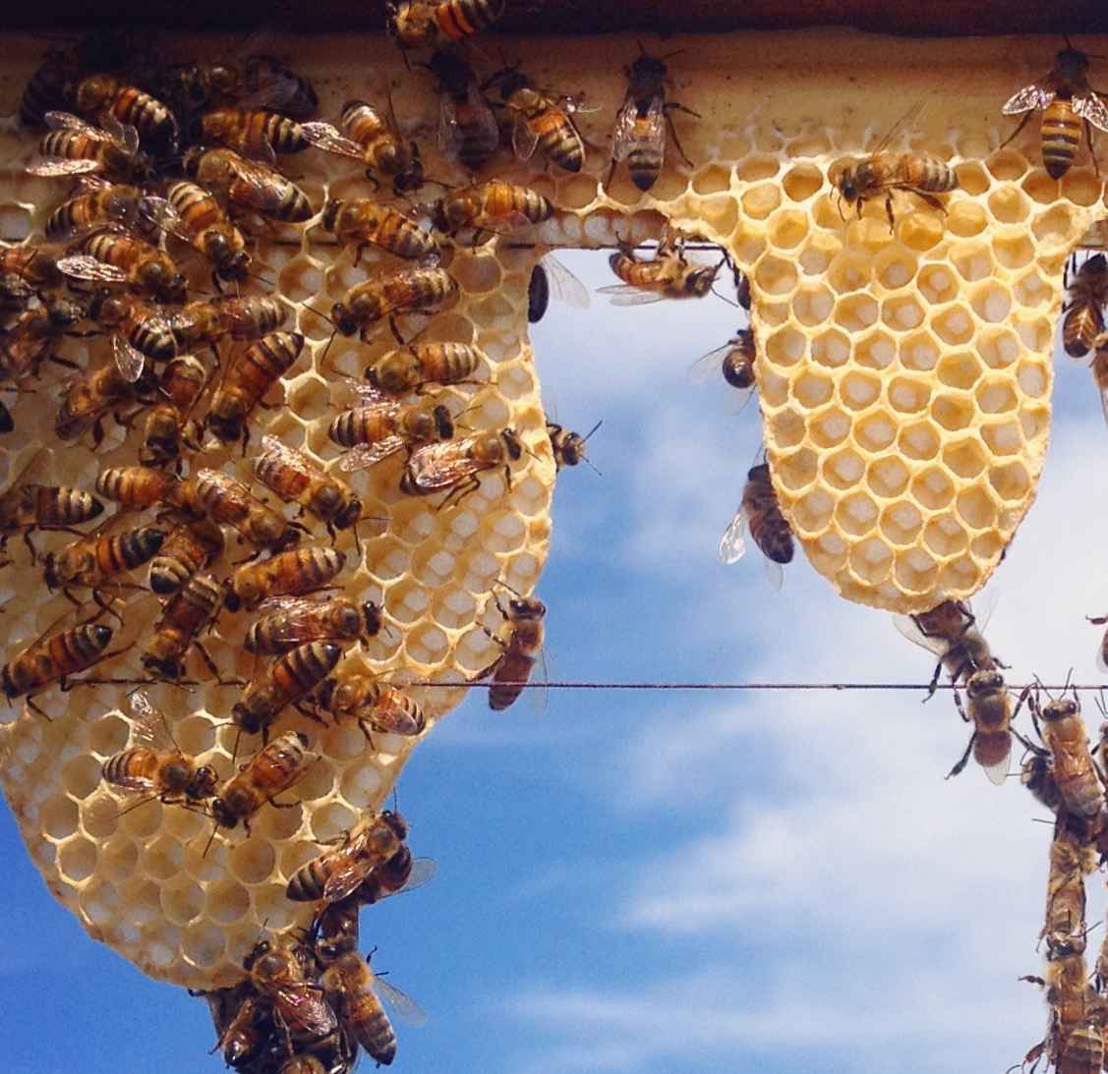
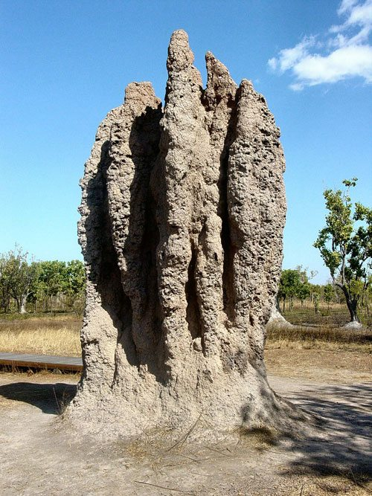
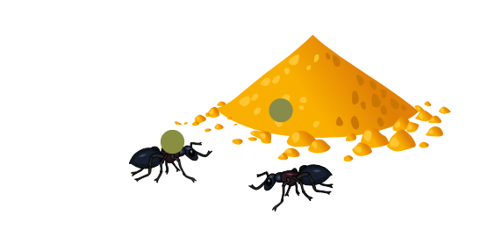
Nature’s Builders
Leaf Cutter Ants
Honey Bees
Agents mark environment with different pheromones
Mound-building termites
Notes:
[Meha]
To help address this problem in construction, we can take inspiration from nature’s builders, particularly insects.
These builders, such as honey bees, ants, and termites, are all examples of a collective system which can perform much better than it’s individual agents. These insects coordinate together to create relatively large and complex structures in an organized and time-efficient manner.
Many do so via stigmergy, a form of indirect communication through the environment. For example an ant marking a path with pheromones which other ants will recognize. This behavior can be characterized as swarm intelligence.

Slide 5
Significance
Context
Inchworm robots need to pick up blocks from block storage area (quarry) and place them on specific locations of the structure under construction
We aim to plan the path of one 5-DOF inchworm robot in the context of a multi-robot system trying to build a structure
Research question
How to plan the inchworm robots’ motion to pick up a block from the quarry and place in a given location on the structure under construction?
Notes:
[Meha]
For this solution to come to life, it has somewhat been divided into 2 sub problems. The first one is creating stigmergic blocks that can update itself, which is what the MQP is focusing on, and the second part that we are focusing on, which is planning the inchworm path using LEDs and range sensors to pick up the stigmergic blocks from the quarry, or the home location, and place it in the stigmergic structure to develop the desired building.

Slide 6
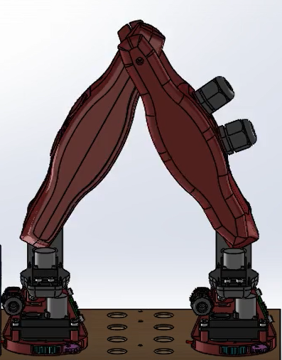
Simulation Environment
RVIZ
Simple Path Planning tester
Used to develop path planner
Used as visualizer for Gazebo
Gazebo
Final simulator (for the project)
Contains playground, blocks, and inchworm
Models magnetic interaction between end effector and blocks/playground
Notes:
[Alex]
Due to the Covid19 pandemic, we will not be implementing this project on physical hardware. However, we plan on getting as close as possible: a full physics simulator
2 tools will be used throughout the development RVIZ and Gazebo

Slide 7
Methods to Inchworm Motion Planning
Path Planning
Define the path from start to end node that the inchworm can follow
Start with simple path planning algorithm
Introduce collision considerations and movement costs
[Reach] Implement motion restrictions throughout the path
Collision avoidance
Take in consideration limitations of the robot (ie can’t plan straight upwards without a building)
[Reach] Add 3D consideration (climbing on existing blocks)
Motion Planning
How does the inchworm follow the path?
Option 1: Preemptive “Footstep” planning
Option 2: Real-time “Footstep” planning
Develop inchworm walking gait
[Reach] Develop inchworm climbing gait
Notes:
[Nicole]

Slide 8
Path Planning: Path Generation
A*
Good base to start with and play around with the heuristics to better suit our needs.
RRT* (Rapidly Exploring Random Tree)
Exploring in a tree pattern, removing unused branches
RAGS (Risk Aware Graph Search)
Giving cost to edges that are revealed dynamically, paths selected with high probability of low cost
Notes:
[Nicole]
For the path generation there are many different algorithms that we can choose from. The major three we are looking at are A*, RRT* and RAGS. As we begin work in the simulation and create a full map to work in. We will be able to decide which is the best for us going forward. While A* is always a go to RRT* could be helpful for a more complicated structures. RAGS is a good dynamic solution to our problem but as we get more complex with multiple robot it might not be as efficient as the other algorithms.

Slide 9
Path Planning: Collision Detection & Motion Restriction
Creating a communication network
Timed intervals for robots to exchange information with neighbors
Robots that fail will be removed from the system / seen as an obstacle
Creating a primary tree and feedback tree for the robot
Puting all robots into a heighercy
All robot will move at the same speed with or without a block
Notes:
[Nicole]
For our reach goal of creating a multi robot system with collision detection and motion restriction we first will create a basic hierarchy to help connect them all. This means the creation of parent and children robots so one will have a high rating meaning it will have the primary path trajectory and go first. When the even a robot fails it will be removed from the system and be changed to an obstacle. All this information is communicated over a network that updated at preset time intervals. So simplify the math we will have the robots go at a constant speed when traveling with and without a block so acceleration will never be a problem.

Slide 10
[Reach] Path Planning: 3D Movement
Modify Face* algorithm: By previous team
Finds path from Block A to Block B on 3D structure
Modification of Dijkstra: Proven complete
Accounts for reachability and space surrounding block
Not optimal
Gait motion
Footstep planning and control (later slides)
Notes:
[Sri]

Slide 11
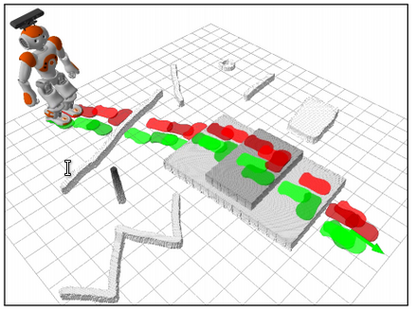
Motion Planning: Preemptive Footstep Planning
List all potential footsteps, and search!
Recursive Fuzzy-Search to find all possible footsteps
Graph Search for finding ideal path (A*, WA*, ARA*, R* considered)
Notes:
[Alex]

Slide 12
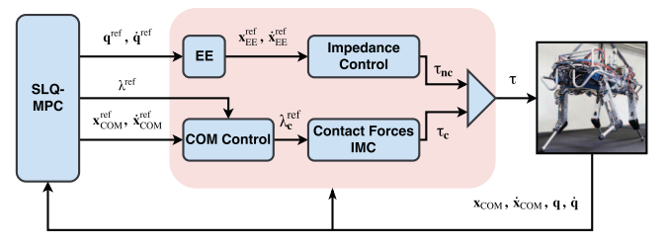
Motion Planning: Real-time Footstep Planning (alternative)
Dynamic footstep planning using Model Predictive Control as options
Expands to support unexpected situations
2 controller options:
FastSLQ
FastSQL-MPC
More complicated, will not implement
Notes:
[Alex]

Slide 13
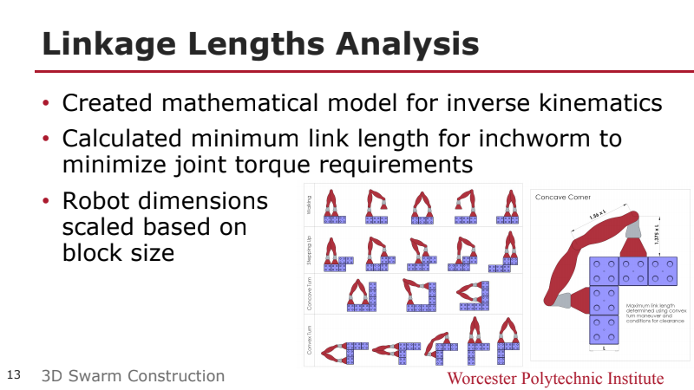
Motion Planning Gaits
4 main gaits → focus on first one
Game Plan:
Finite State Model
Trajectory Planning
One foot will always be stationary
Notes:
[Meha]
To plan the motion of the inchworm gaits, we look to the 4 main gaits identified by the previous MQP. For the scope of this class we will focus on the first one which navigates a plane, no 3D obstacles.
To achieve this, we are going attack this in a 2-parter.
The overarching method we would be using is a finite state model - this method allows us to tell the robot, hey time to take a step by 1 with your front foot, time to move by 1 back foot, and any other base motion groups.
Each of the states will be achieved using trajectory planning, similar to what we did in 3001 - if there are any undergrads here. So the idea here is that since both feet will not be moving at the sametime, we can safely treat each state like an armed robot.
We believe this 2 step approach can simplify this goal into achievable tasks.
https://ieeexplore.ieee.org/stamp/stamp.jsp?tp=&arnumber=770405

Slide 14
Resources
Mentors
Part of larger MQP project
Working with Professor Carlo Pinciroli, Gregory Lewin and Andrew Clark
Hardware
Previous MQP team’s robot
Software
Block’s Motion Algorithm from current MQP
Notes:
[Meha]
As far as our resources are concerned, since this being worked alongside an MQP, we have support from our MQP teammates and advisors
We have the physical robot to use as a model and MAYBE make actually move
And since the MQP is working on the stigmergic material, we will have the block’s motion algorithm which will develop the queue for where the inchworm should inch to next.

Slide 15
Goals
Minimum Deliverables
Fully setup simulation playground
Inchworm robot able follow the gait
Expected Deliverables
Functional Path planning algorithm visualized in the simulation
Foot step planning for inchworm robot
Inchworm robot followed layout plan in simulation
Reach Deliverables
Motion planning of robot with block
Creation of a 3D walking gait
3D path planning
Creating a multi-robot system
Notes:
Sri
Set-Up Simulator
Make Github Repob
URDF Model for Inchworm in Gazebo
Basic Kinematic Control System & Gait System for inchworm
End Effector design + control system
Block URDF + control system
Comms between inchworm and structure
The Meat
Meha Chopra Mohapatra is inviting you to a scheduled Zoom meeting.
Topic: Meha Chopra Mohapatra's Personal Meeting Room
Join Zoom Meeting
Meeting ID: 818 497 6659
One tap mobile
+13017158592,,8184976659# US (Washington DC)
+13126266799,,8184976659# US (Chicago)
Dial by your location
+1 301 715 8592 US (Washington DC)
+1 312 626 6799 US (Chicago)
+1 646 876 9923 US (New York)
+1 253 215 8782 US (Tacoma)
+1 346 248 7799 US (Houston)
+1 669 900 6833 US (San Jose)
Meeting ID: 818 497 6659
Find your local number: https://wpi.zoom.us/u/acC5HsvWiH
Join by SIP
8184976659@zoomcrc.com
Join by H.323
162.255.37.11 (US West)
162.255.36.11 (US East)
213.19.144.110 (Amsterdam Netherlands)
213.244.140.110 (Germany)
103.122.166.55 (Australia Sydney)
103.122.167.55 (Australia Melbourne)
69.174.57.160 (Canada Toronto)
65.39.152.160 (Canada Vancouver)
207.226.132.110 (Japan Tokyo)
149.137.24.110 (Japan Osaka)
Meeting ID: 818 497 6659
Join by Skype for Business
https://wpi.zoom.us/skype/8184976659

Slide 16
Timeline
March 30th
April 16th
April 29th
May 12th
Development Environment Setup
Control System Development
Expected Deliverables
Schedule Leeway
Fully set up Gazebo playground
Kinematic Model of inchworm in Gazebo
Testing path algorithms
Visualize path attempts in RVIZ
Robot can take a step
Debug decided path algorithm
Path Planning algorithm for inchworm complete
Footstep Planning algorithm final debug stage
Complete expected algorithm visualized in RVIZ
Work completed on selected reach goal
Notes:
[Alex]

Slide 17
Project Summary / Questions?
Project Components
Research Questions | How to plan the inchworm robots’ path from one place to another in 2D and 3D options?
Application Impacts | Reduce injury and increase efficiency when laying down a structure’s scaffolding/foundation
Related Work | Inchworm robot path planning in organized environments
Autonomy Design | Propose and implement an algorithm to Find a path from one point to another on a playground Plan motion of how the inchworm will follow that path (walking gait, kinematics, trajectories, etc).
Evaluation | Test to achieve all goals
Platform | Simulator interface developed in Gazebo and RVIZ
Team “Leader” | Sriranjani Kalimani
Project Capacity | 4 Students
Notes:
[Alex]

Slide 18
References
[Online]. Available: http://docs.ros.org/en/melodic/api/gazeboplugins/html/groupGazeboRosVacuumGripper.html.
Cameron Collins, Josue Contreras, Neel Dhanaraj, Hannan Liang, Trevor Rizzo, Caleb Wagner, “Swarm construction: A method in multi-agent robotic assembly,”2020. [Online]. Available: https://web.wpi.edu/Pubs/E-project/Available/E-project-051620-143223/unrestricted/3DSwarmConstructionFinalReport.pdf.
I.-M. Chen, S. H. Yeo, and Y. Gao, “Locomotive gait generation for inchworm-like robots using finite state approach,” Robotica, vol. 19, no. 5, pp. 535–542, 2001. DOI: 10.1017/S0263574700003271.
J. Chestnutt, “Navigation planning for legged robots,” 2007. [Online]. Available: http://www.cs.cmu.edu/∼cga/papers/chestnutt-thesis.pdf.
S. Chitta, E. Marder-Eppstein, W. Meeussen, V., Pradeep, A. Rodrı́guez Tsouroukdissian, J. Bohren, D. Coleman, B. Magyar, G. Raiola, M. Lüdtke, and E. Fernández Perdomo, “Ros control: A generic and simple control framework for ros,” The Journal of Open Source Software, 2017. DOI: 10 . 21105 / joss . 00456. [Online]. Available: http://www.theoj.org/joss-papers/joss.00456/10.21105.joss.00456.pdf.
F. Farshidian, E. Jelavic, A. Satapathy, M. Giftthaler, and J. Buchli, “Real-time motion planning of legged robots: A model predictive control approach,” in 2017 IEEE-RAS 17th International Conference on Humanoid Robotics (Humanoids), 2017, pp. 577–584. DOI: 10.1109/HUMANOIDS.2017.8246930.
Ghanbari A., Rostami A., Noorani S.M.R.S., Fakhrabadi M.M.S, “Modeling and simulation of inchworm mode locomotion,” 2008. DOI: 10.1007/978-3 -540-88513-966. [Online]. Available: https://link.springer.com/chapter/10.1007/978-3-540-88513-9 66#citeas.

Slide 19
Related Work
B. Jenett and K. Cheung, “Bill-e: Robotic platform for locomotion and manipulation of lightweight space structures,” in 25th AIAA/AHS Adaptive Structures Conference. DOI: 10 . 2514 / 6 . 2017 - 1876. eprint: https://arc.aiaa.org/doi/pdf/10.2514/6.2017- 1876. [Online]. Available:https://arc.aiaa.org/doi/abs/10.2514/6.2017-1876.
P. H. Kourosh Nader Joose Rajamaki, “Rt-rrt*: A real-time path planning algorithm based on rrt*,” 2015. DOI: 10.1145/2822013.2822036. [Online]. Available: https://users.aalto.fi/ ∼hamalap5/FutureGameAnimation/p113-naderi.pdf.
D. Pagano, “Uncertainty modelling and motion planning of an inchworm robot navigating in complex structural environments,” 2018.
R. K. Utkarsh Kumar Adrish Banerjee, “Collision avoiding decentralized sorting of robotic swarm,” 2020. DOI : 10.1007/s10489- 019- 01602- 5. [Online]. Available: https://link.springer.com/article/10.1007%2Fs10489-019-01602-5.
Vacuum/magnetic feet for a walking robot edit. [Online]. Available:https://answers.gazebosim.org//question/14462/vacuummagnetic-feet-fo-a- walking-robot/.
S.-H. Yeo, I.-M. Chen, R. S. Senanayake, and P. S. Wong, “Design and development of a planar inchworm robot,” in Proceedings of the 17th IAARC/CIB/IEEE/IFAC/IFR International Symposium on Automation and Robotics in Construction, M.-T. Wang, Ed., Taipei, Taiwan: International Association for Automation and Robotics in Construction (IAARC), Sep. 2000, pp. 1–6, ISBN : 9789570266986. DOI:10.22260/ISARC2000/0075.

Slide 20
References
A. Hornung, A. Dornbush, M. Likhachev, and M. Bennewitz, “Anytime search-based footstep planning with suboptimality bounds,” in 2012 12th IEEE-RAS International Conference on Humanoid Robots (Humanoids 2012), 2012, pp. 674–679. DOI:10.1109/HUMANOIDS.2012.6651592.
Jen Jen Chung, Ander J. Smith, Ray Skeele, Geoffrey A. Hollinger, “Risk-aware graph search with dynamic edge cost discovery,” The International Journal of Robotics Research, 2018. DOI:10.1177 / 0278364918781009. [Online]. Available:https://journals.sagepub.com/doi/10.1177/0278364918781009.

